Slide 1
IPW for non-binary exposures
Sarah Ruth Hoffman
January 14, 2019
Pharmacoepidemiology Seminar

Slide 2
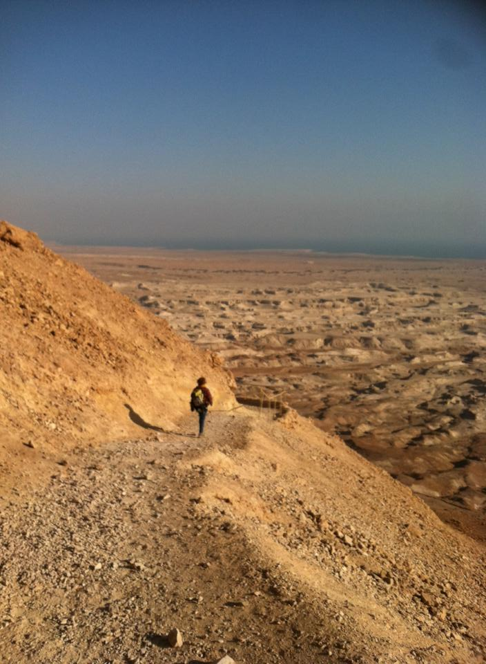
A Journey within a Journey…!

Slide 3
Levels
Degree program
Dissertation
Aim 2
IPW Models
Rabbit Hole 1
Rabbit Hole 1a
Rabbit Hole 2…
∞
You are Here.

Slide 4
Think of this as Part 1 of n
Notes:
Presentation

Slide 5
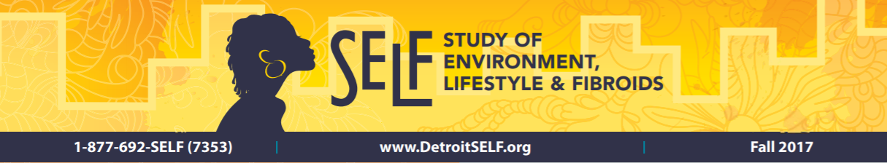
SELF Cohort
Black women (no prior hyst or fibroids)
Detroit, MI
Recruited 1,696 women ages 23-34 in 11/2010-12/2012
Commitment to stay in Detroit area for 5 years
Notes:
Presented this slide in May when discussing Aim 1
“From November 2010 to December 2012, we screened 3200 women, and 89% were found to be eligible for the study”
Henry Ford Health System (HFHS) est. 1915 letters
“website (detroitself.org); fliers, brochures at health care clinics (all obstetrics and gynecology clinics were contacted and, if willing to participate, were sent brochures to display); local radio, television, newspaper, and magazine advertisements; and information booths at community events”
“Enrollment was not complete until the clinic visit and the four questionnaires (CATI, CAWI, FFQ, and self-administered Pre-enrollment Questionnaire) were completed.”
https://www.ncbi.nlm.nih.gov/pubmed/26334691

Slide 6
Dissertation Aims
Aim 1 – Patterns of Hormonal Contraceptive Use
Complete
Presented at ICPE 2018
Editing manuscript for Contraception
Aim 2 – COC Use and UF Incidence
Modeling
Aim 3 – COC Use and Fibroid Growth
Notes:
Presented this slide in May when discussing Aim 1 (no aim is every complete)
“From November 2010 to December 2012, we screened 3200 women, and 89% were found to be eligible for the study”
Henry Ford Health System (HFHS) est. 1915 letters
“website (detroitself.org); fliers, brochures at health care clinics (all obstetrics and gynecology clinics were contacted and, if willing to participate, were sent brochures to display); local radio, television, newspaper, and magazine advertisements; and information booths at community events”
“Enrollment was not complete until the clinic visit and the four questionnaires (CATI, CAWI, FFQ, and self-administered Pre-enrollment Questionnaire) were completed.”
https://www.ncbi.nlm.nih.gov/pubmed/26334691

Slide 7
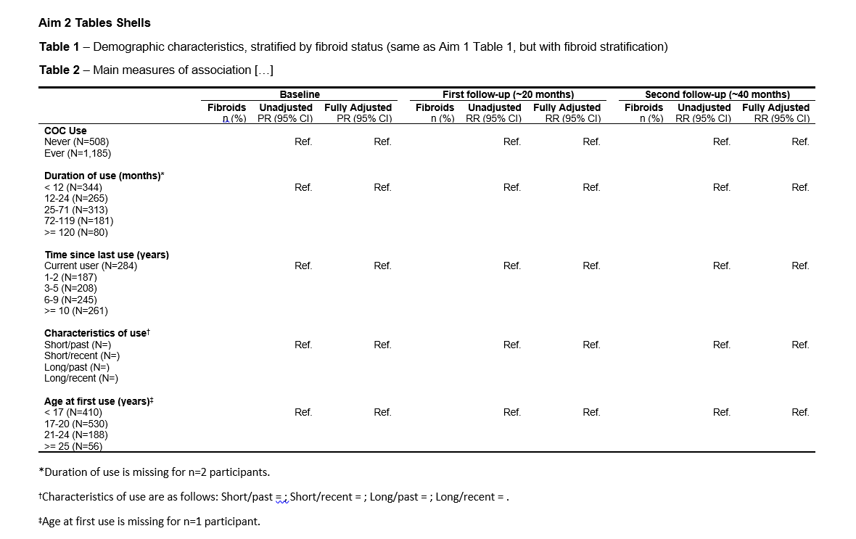
Notes:
Goal in life is to fill out this table
Approach to filling out this table
Name exposures

Slide 8
Why IPW?
Enhanced interpretability
Fit more covariates
Transparent (can look at covariate balance)
Notes:
As opposed to conditional model
No comment on the philosophy, as that is another presentation altogether
Focus on the mechanics

Slide 9
What do I need to do this?
IPW normally taught in binary exposures
No leads on how to do this for non-binary exposures
Not something I have seen before
Notes:
When somebody gives me a task, my next thought is… Gaps… To be fair…2015

Slide 10
EPID 722: Brookhart Code Steps
Create a PS model
Plot the overlap of the PS distributions by treatment group
Compute weights
Output weighted and unweighted Table 1
Weighted linear regression for final estimate
Notes:
PS = propensity score

Slide 11
Questions That Arise
What type of model for estimating PS?
What probability do we even want?
What PS distributions to examine?
How to evaluate covariate balance?
What does my final estimate even mean?
ATT or ATE and what probabilities to calculate for each?

Slide 12
Three Resources
Naimi (2014)
Other minds at UNC and beyond
What SAS gives me/Empiricism/Actually doing
Notes:
Literature, other people, and experience (Trial & Error).

Slide 13
Literature

Slide 14
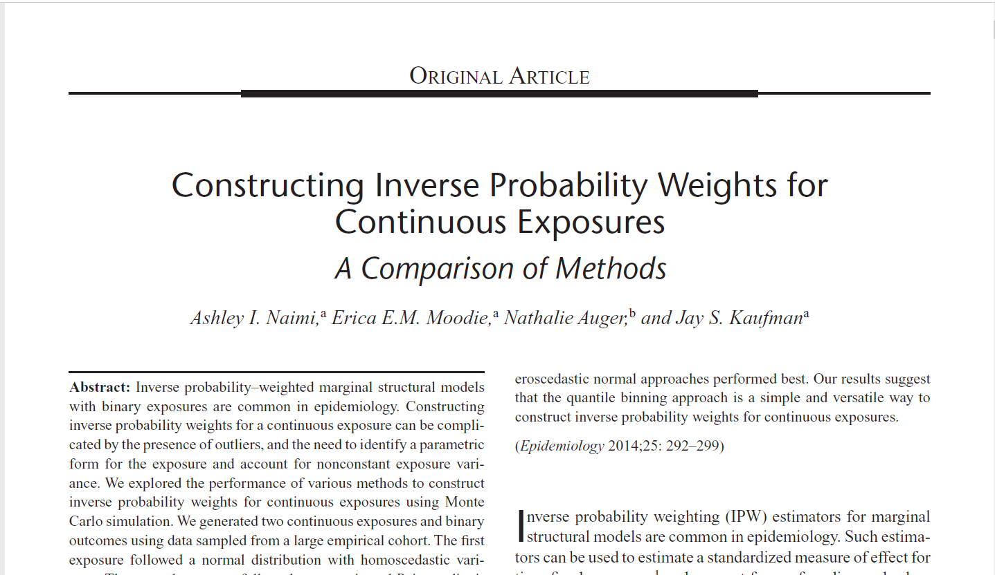

Slide 15
Naimi (2014)
“We explored the performance of various methods to construct inverse probability weights for continuous exposures using Monte Carlo simulation.”
Continuous exposures, binary outcomes
Two types of exposures:
Normal distribution, with homoscedastic variance
Poisson distribution, with heteroscedastic variance
Notes:
How this relates to my own data…

Slide 16
Naimi (2014)
Three Complicating Factors:
“the need to identify a correct distributional form for the exposure,
the need to account for nonconstant exposure variance (heteroscedasticity),
and the need to deal with outliers that can make highly variable weights more likely”
Sarah’s 4th: “How to even think about this?”
Notes:
They noted… continuous exposures…
To wrap one’s mind around it can be a challenging thing.

Slide 17
Naimi (2014)
We assessed six methods to construct inverse probability weights using:
a normal distribution,
a normal distribution with heteroscedastic variance,
a truncated normal distribution with heteroscedastic variance,
a gamma distribution,
a t distribution (1, 3, and 5 degrees of freedom),
and a quantile binning approach (based on 10, 15, and 20 exposure categories).
Notes:
Distribution of what?
Hey! That’s essentially what I’m doing, just with more categories!

Slide 18
Naimi (2014)
Method | Normal/Homoscedastic | Poisson/Heteroscedastic
Normal | 🏆
Normal/Heteroscedastic |  | 🏆
Truncated Normal/Heteroscedastic
Gamma | 🏆 | 🏆
t (1,3,5 df)
Quantile binning | 🏆 | 🏆
“Our results suggest that the quantile binning approach is a simple and versatile way to construct inverse probability weights for continuous exposures.”
Notes:
“quantile binning is a relatively simple approach that makes no assumptions about the distribution of the exposure”

Slide 19
Take Aways
What kind of model for PS estimation?
Cumulative logistic regression
How did they interpret final estimates? Substantive meaning?
Notes:
Simulation paper, not usually the emphasis

Slide 20
Other Minds

Slide 21
Other Minds
Wrote to Naimi
Wrote to Conover & Breskin
Wrote Harmon
Talked to Poole
Talked to Jonsson Funk
Talked to Hudgens
Tip: Output useful e-mail threads to PDFs for easy access

Slide 22
A Simple (?) Question
What model to use for estimating PS?
Cumulative logit for multilevel ordinal
SAS Paper: “When PROC LOGISTIC encounters a model with a dependent variable that has more than two categories, it automatically uses the cumulative logit to perform the analysis. Be careful: make sure that the dependent variable is ordinal and not nominal!”
Other mind: Multinomial (generalized) might be better, as cumulative in my experience can yield strange estimates.
Notes:
Logistic regression
PS model has exposure as the dependent variable

Slide 23
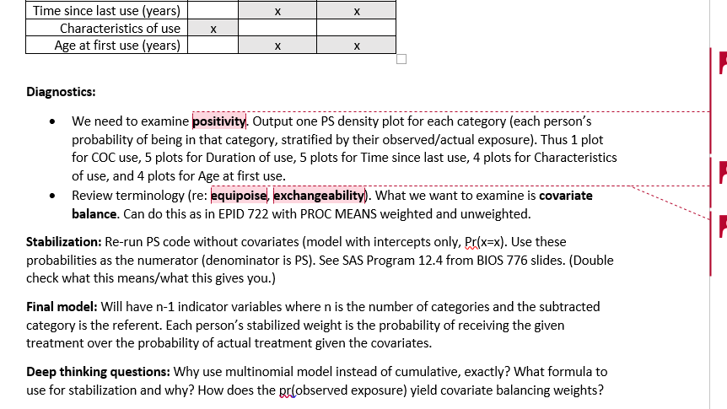
Notes:
Hudgens
Assembled a document for myself

Slide 24
Trial & Error

Slide 25
b_ch2_cat | Frequency | Percent | Cumulative Frequency | Cumulative Percent
0 | 410 | 34.63 | 410 | 34.63
1 | 530 | 44.76 | 940 | 79.39
2 | 188 | 15.88 | 1128 | 95.27
3 | 56 | 4.73 | 1184 | 100.00
Frequency Missing = 1
Age under 17 = 0

Slide 26
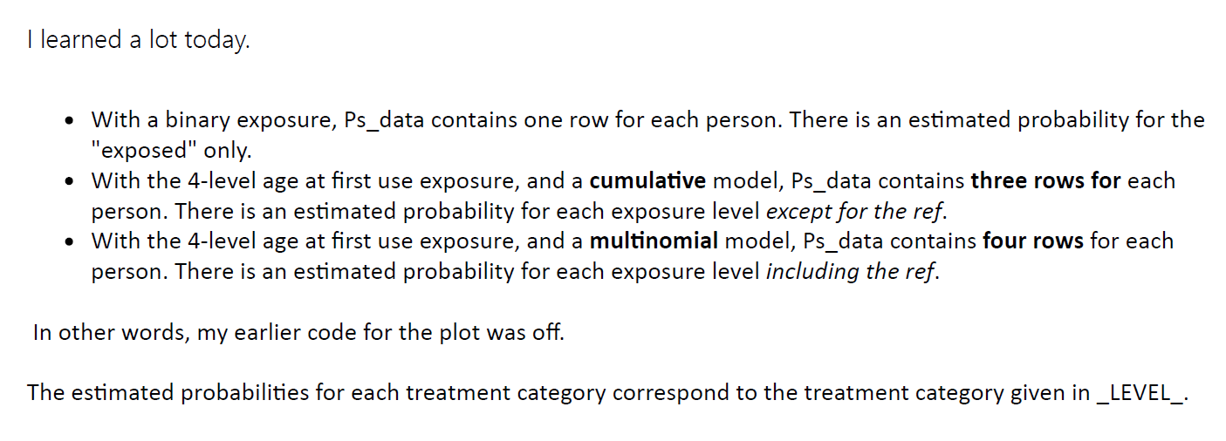
Notes:
This is how we are taught in class…
Estimate P(observed exposure)

Slide 27
***estimate PS using multinomial logistic regression;
proc logistic data=age_first_use descending;
class b_ch2_cat;
model b_ch2_cat = b_smoke b_income b_bmicat b_menarcage /link=glogit;
output out=ps_data_1 predicted=ps;
run;

Slide 28
Notes:
Hudgens
Assembled a document for myself

Slide 29
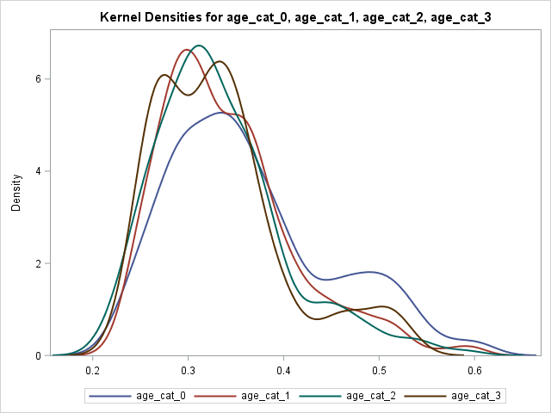
P(trt=0) by observed trt
Notes:
Smoking income BMI age at menarche

Slide 30
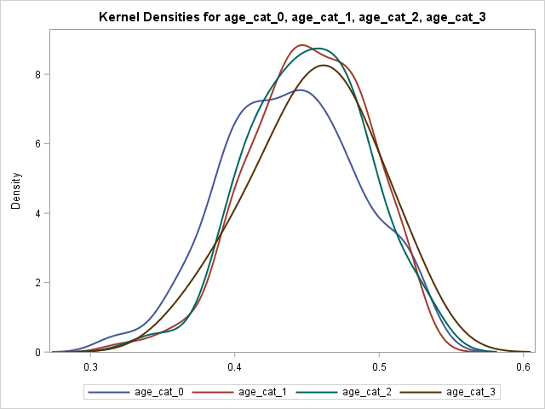
P(trt=1) by observed trt
Notes:
Smoking income BMI age at menarche

Slide 31
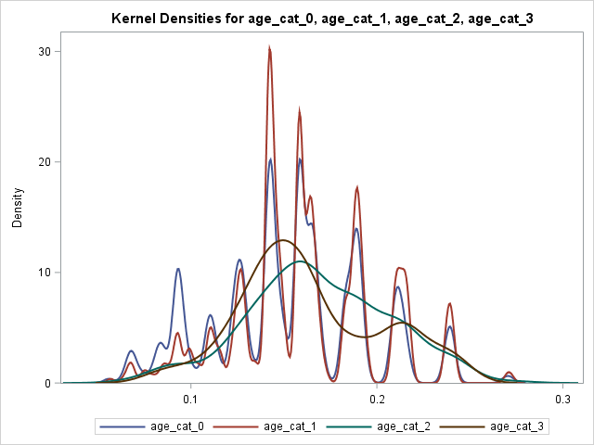
P(trt=2) by observed trt
Notes:
Smoking income BMI age at menarche

Slide 32
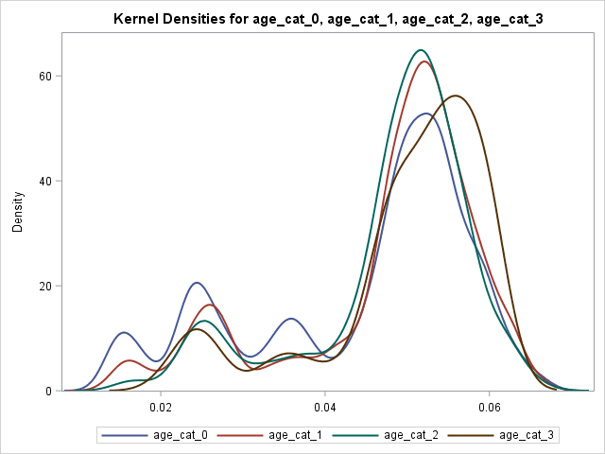
P(trt=3) by observed trt
Notes:
Smoking income BMI age at menarche

Slide 33
Next Steps
Already completed but no time to make into slides
Was able to create weights
Achieved covariate balance for the three, but…
Re-assessing everything given new guidance and information…
The journey continues…

Slide 34
Continuing Exploration…
Why use multinomial model instead of cumulative, exactly? Do some digging…
What formula to use for stabilization and why?
And many more…
Notes:
“I don’t understand it for myself yet.”

Slide 35
A Journey

Slide 36
Thank You!
Alex Breskin
Mitch Conover
Ashley Naimi
Committee Members
Quaker Harmon
Charlie Poole
Michael Hudgens
Michele Jonsson Funk
Notes:
Committee Members who helped with this!

Slide 37
The End

Slide 38
Contents
EPID 722 (Spring 2015) basic IPW process
Questions that arise
Literature review
Naimi (2014) – Quantile binning
Performing EPID 722 on non-binary exposures
Remaining questions

